Slide 1
Docker Container – Network Enhancements
Oct18th 2016
Notes:
This is a sample Title Slide with Picture ideal for including a dark picture with a brief title and subtitle.
A selection of pre-approved title slides are available in the HPE Title Slide Library. The location of the library will be communicated later.
To insert a slide with a different picture from the HPE Title Slide Library:
Open the file HPE_16x9_Title_Slide_Library.pptx
From the Slide thumbnails pane, select the slide with the picture you would like to use in your presentation and click Copy (Ctrl+C)
Open a copy of the new HPE 16x9 template (Standard or Events) or your current presentation
In the Slide thumbnails pane, click Paste (Ctrl+V)
A Paste Options clipboard icon will appear. Click the icon and select Keep Source Formatting. (Ctrl+K)

Slide 2
Docker Container Network Bandwidth Management
Siva Ramaprasad Cherukuru

Slide 3
Agenda
Docker Container – Network Bandwidth Management proposed solution
Demo – using iperf server running inside Docker

Slide 4
Problem statement
Current Behavior (Resource Management)
Docker Framework provides options to manage CPU and Memory resources
No option to manage Network Bandwidth for a container at Host level
Problem Statement
Network bandwidth utilization of one application container may affect other containers
No guarantee on Network Bandwidth for a container running on a Host
No option to manage the network bandwidth to a running Docker container
Also no such option through cloud service providers like Amazons AWS, Microsoft(Azure) or HP’s Helion.
Benefits Docker SWARM to schedule containers based on available n/w IO bandwidth
Benefits in case of DoS attacks

Slide 5
Proposed solution
Use CGROUPS(net_cls and net_prio) along with TC (traffic classifier) to implement network bandwidth management and throttling
Proposing a way to classify the network bandwidth based on
Container Id
- Containers external facing source port on the host.
New plug-in/driver to implement bandwidth management for easy integration with Docker management commands.
Update “$docker network” command to set bandwidth limit to a running container
Dynamically increase/reduce N/W bandwidth limit to a Docker container while it is running

Slide 6
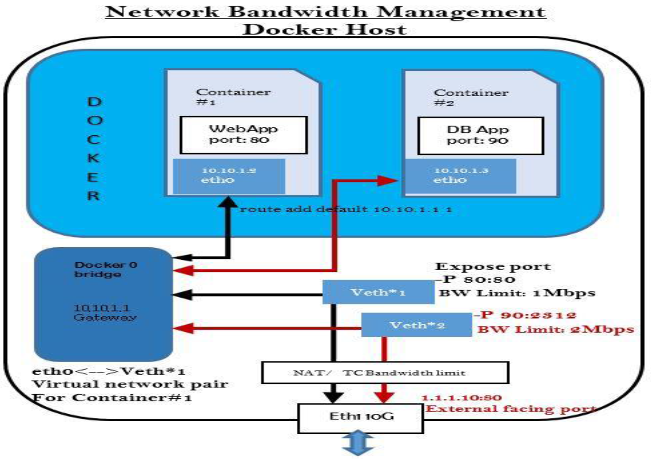
Manage N/W traffic bandwidth in Docker bridge environment where traditionally Linux bridge resides in between the Docker host NIC and container interface.
Also should be capable of managing n/w bandwidth for any new drivers from Docker.
Notes:
This is a sample Picture with Content slide ideal for including a picture with a brief descriptive statement.
To Replace the Picture on this Sample Slide (this applies to all slides in this template that contain replaceable pictures)
Select the sample picture and press Delete. Click the icon inside the shape to open the Insert Picture dialog box. Navigate to the location where the picture is stored, select desired picture and click on the Insert button to fit the image proportionally within the shape.
Note: Do not right-click the image to change the picture inside the picture placeholder. This will change the frame size of the picture placeholder. Instead, follow the steps outlined above.
Tip: use the Crop tool to reposition a picture within a placeholder. From the Picture Tools Format tab on the ribbon, click the Crop button. Click and drag the picture within the placeholder to reposition. To scale the picture within the placeholder (while Crop is active), grab a round corner handle and drag to resize. Hold Shift key to constrain picture aspect ratio when resizing.

Slide 7
Current Status & Next Steps
Current status
- Done prototyping based on the Container’s external facing Port
- Added new option “bw” to “$docker network” command
EX:
Usage: $docker network bandwidth CONTAINER -s RATE -t[kbps|mbps|gbps] –i <host interface name>

Slide 8
Thank You

